Slide 1
Speech
Teoh Teik Toe
ITOM/NBS
ttteoh@ntu.edu.sg
97905202

Slide 2
Topics
Introduction to Speech
Deep Learning on Speech
Code: https://drive.google.com/drive/folders/1fXjR7HWQVDvW4b_UwFmEM_NymlOo4Wbw?usp=sharing
Data:
https://drive.google.com/drive/folders/1DWSSkL9zMwXktar8rxC_3rUGqxwNNTrR?usp=sharing

Slide 3
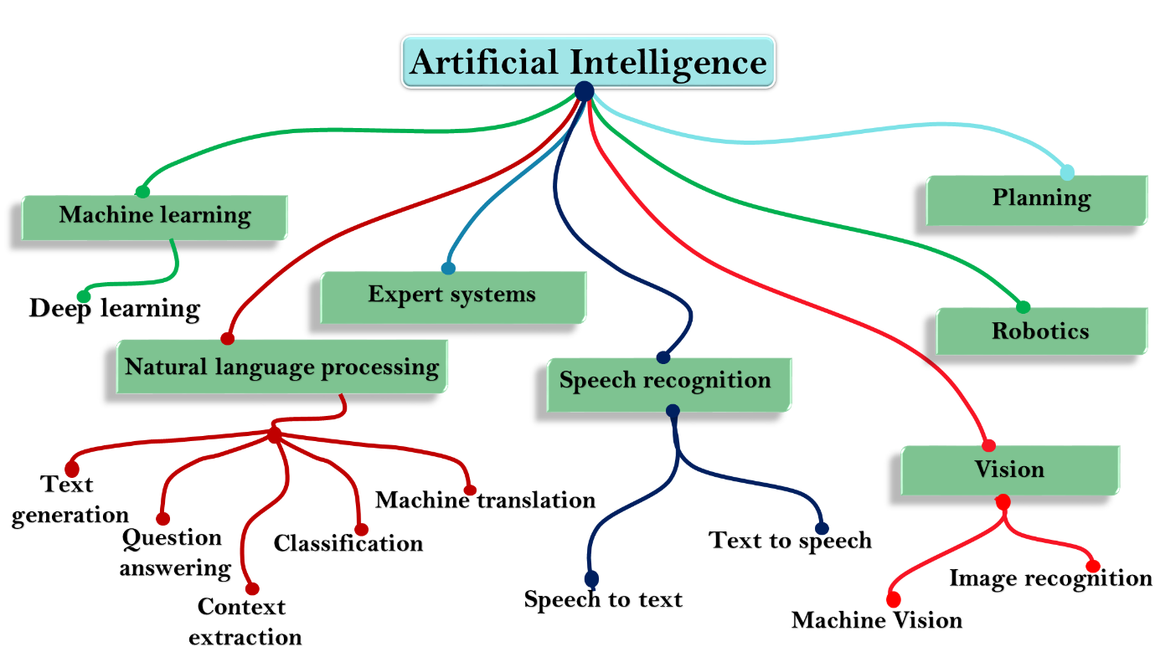
AI

Slide 4
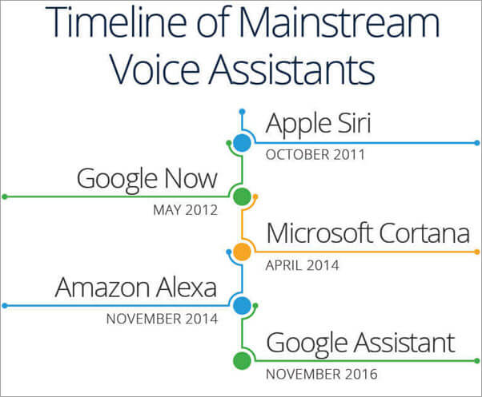
Top Speech Recognition Brand

Slide 5
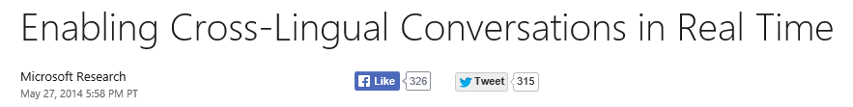
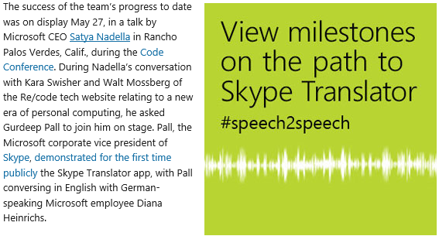
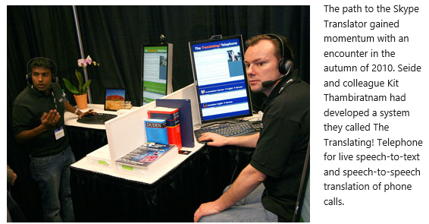
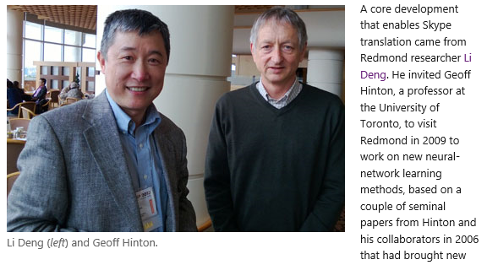

Slide 6
Top ML Model in Speech & NLP
RNN & LSTM
HMM

Slide 7
Speech Format
48khz 16bit => 1 sec will have 48 x 1000 x 2 bytes (16bits) = about 10k byte and 10sec about 100kbyte without compression
A Normal Photo (about 1000 x 1000) pixel RGB (Color) Photo will be 1,000 x 1,000 x 3 byte, about 100k byte without compression
How strong is compression? Depends……
Frequency domain like jpeg will reduce up to 95%.

Slide 8
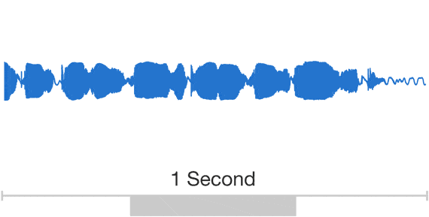
Graphical Representation

Slide 9
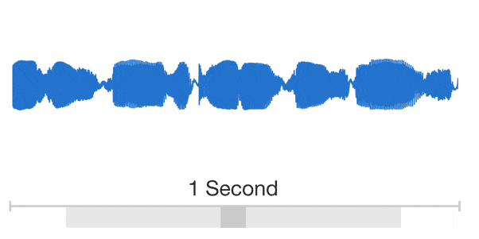
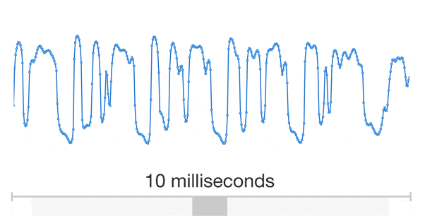
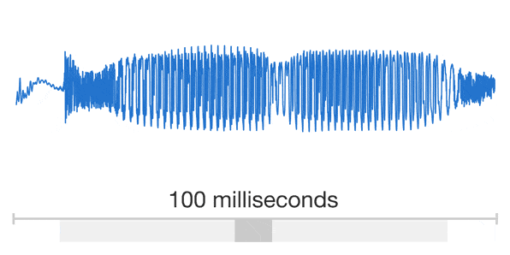
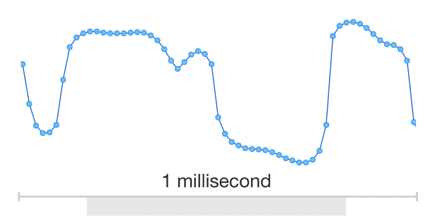

Slide 10
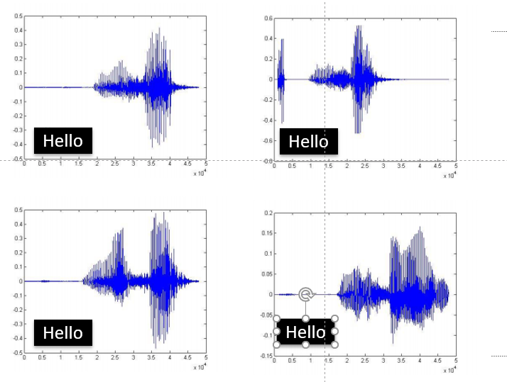
Speech is similar but not exactly the same
Hello
Hello
Hello
Hello

Slide 11
History of automatic speech recognition

Slide 12
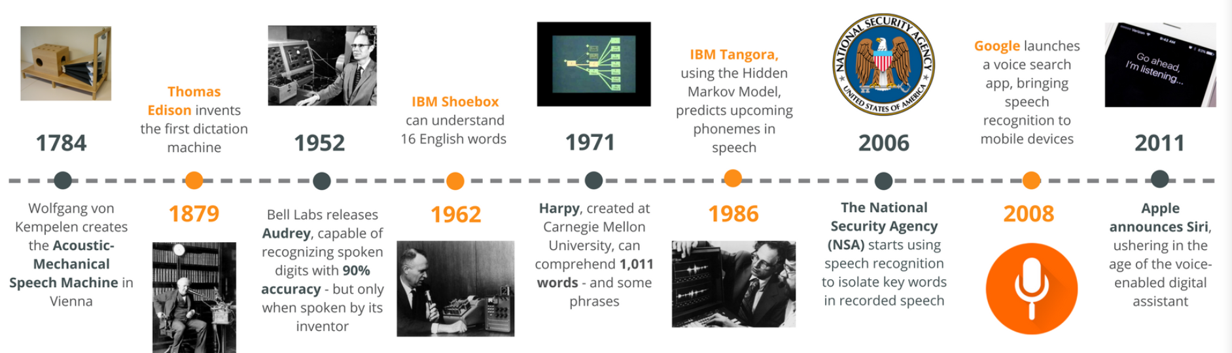
History

Slide 13
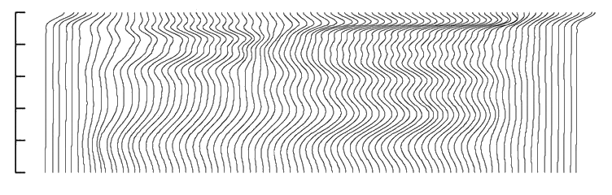
History of Automatic Speech Recognition (ASR)
Mid-Late 1970s: Hidden Markov Models (HMMs) – statistical models of spectral variations, for discrete speech.
Mid 1980s: HMMs become the dominant technique for all ASR
sil
a
i
sil
0
1
2
(kHz)
3
4
5
http://hts.sp.nitech.ac.jp/archives/2.3/HTS_Slides.zip

Slide 14
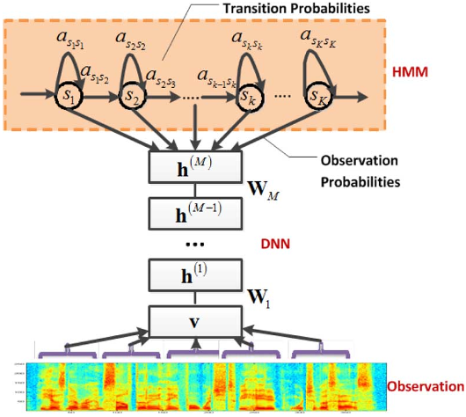
History of Automatic Speech Recognition
1990s: Large vocabulary continuous dictation
2000s: Discriminative training (minimize word/phone error rate)
2010s: Deep learning significantly reduce error rate
George E. Dahl, et al. Context-Dependent Pre-Trained Deep Neural Networks for Large-Vocabulary Speech Recognition. IEEE Trans. Audio, Speech & Language Processing, 2012.

Slide 15
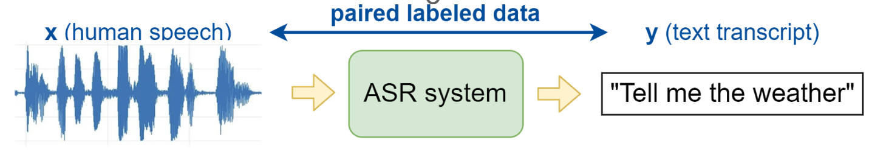
What are we doing today

Slide 16
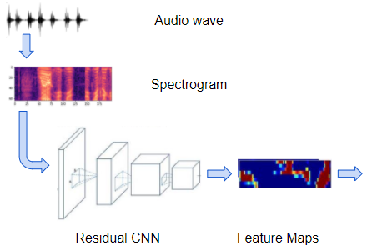
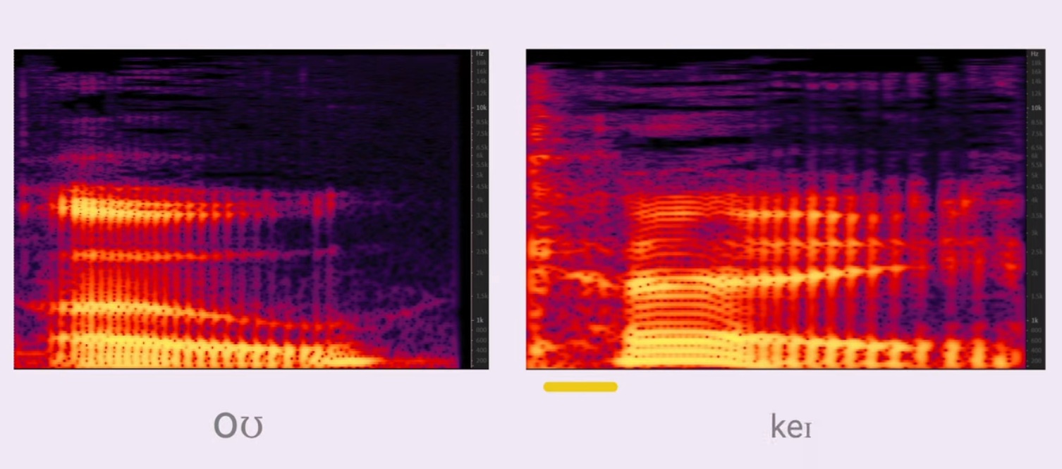
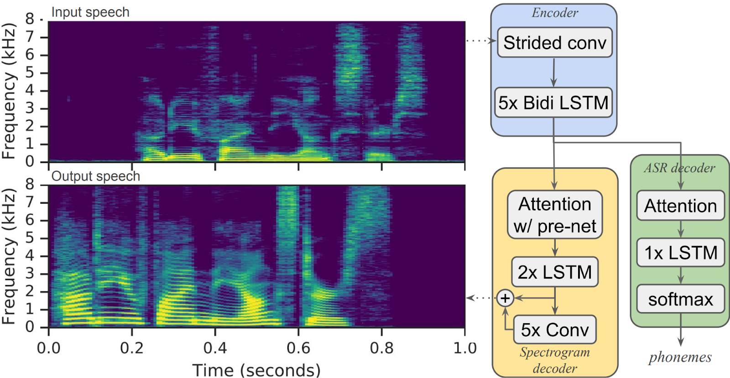
Speech
spectrogram

Slide 17
Speech Recognition (.wav)
To read:
import winsound
winsound.PlaySound("Welcome.wav", winsound.SND_FILENAME)
#pip install SpeechRecognition
#May need to upgrade pip : python -m pip install --upgrade pip (conda prompt)
pip install SpeechRecognition
import speech_recognition as sr
a = sr.AudioFile("/content/drive/MyDrive/TT Library/AI Model/Data/Welcome.wav")
with a as source:
a = sr.Recognizer().record(source)
print(sr.Recognizer().recognize_google(a))
With statement is same as :
Try, Except, Else, Finally
Sample Wave file https://www.voiptroubleshooter.com/open_speech/american

Slide 18
Speech to Text (MicroPhone) – Not in Colab
#pip install SpeechRecognition
#pip install pyaudio
!pip install PyAudio
import speech_recognition as sr
r = sr.Recognizer()
print("please say something in 4 seconds... and wait for 4 seconds for the answer.....")
print("Accessing Microphone..")
with sr.Microphone() as source:
r.adjust_for_ambient_noise(source, duration=2)
print("Waiting for you to speak...")
audio = r.listen(source)
try:
print("You said " + r.recognize_google(audio))
except:
print("Please retry...")
Sometimes you may need
#pip install pipwin
#pipwin install pyaudio

Slide 19
Optional

Slide 20
BackEnd
from flask import Flask, render_template, request
from werkzeug.utils import secure_filename
import speech_recognition as sr
app = Flask(__name__)
@app.route('/', methods=['GET', 'POST'])
def upload_file():
if request.method == 'POST':
file = request.files['file']
print("File Received")
filename = secure_filename(file.filename)
file.save("static/" + filename)
a = sr.AudioFile("static/" + filename)
with a as source:
a = sr.Recognizer().record(source)
s = sr.Recognizer().recognize_google(a)
return(render_template("index.html", result=s))
else:
return(render_template("index.html", result="2"))
if __name__ == "__main__":
app.run()

Slide 21
FrontEnd
<html>
<h1>Upload new File</h1>
<form method="post" action = "/" enctype="multipart/form-data">
<input type="file" name="file">
<input type="submit" value="Upload">
</form>
{{result}}
</html>

Slide 22
requirements.txt
click==8.0.4
colorama==0.4.4
Flask==2.0.3
itsdangerous==2.1.0
Jinja2==3.0.3
MarkupSafe==2.1.0
SpeechRecognition==3.8.1
Werkzeug==2.0.3
gunicorn

Slide 23
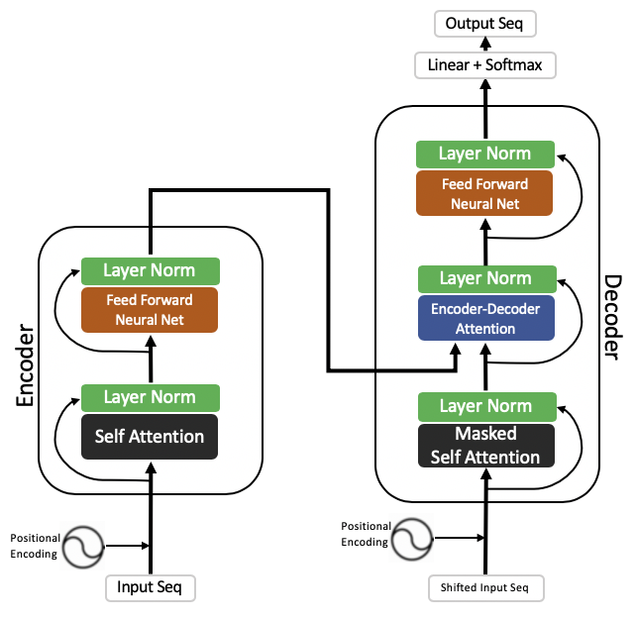
Transformer, Encoder, Attention RNN
The transformer is the model, while the attention is a technique used by the model.

Slide 24
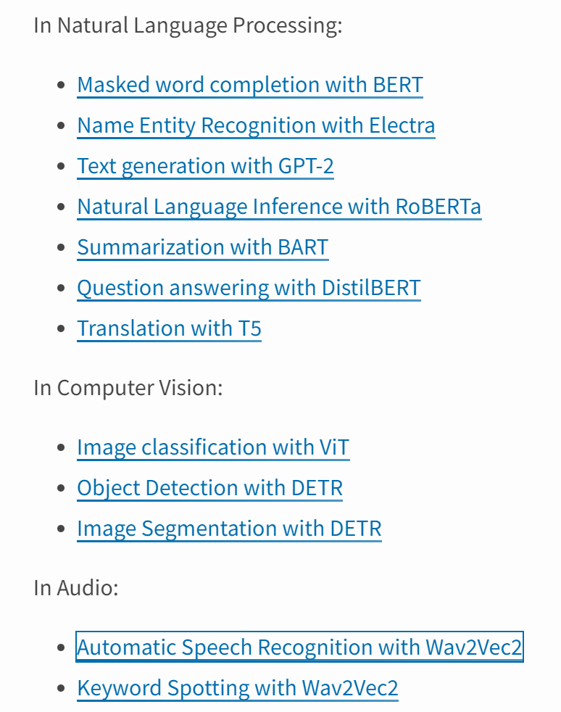
Transformer – Python Library - https://pypi.org/project/transformers/

Slide 25
Speech Recognition
#!pip3 install transformers==4.11.2 soundfile sentencepiece torchaudio pydub pyaudio
#!pip install transformers –U
pip install transformers
pip install tensorflow
import tensorflow as tf
import torch
import soundfile as sf
# import librosa
import os
import torchaudio
model_name = "facebook/wav2vec2-base-960h" # 360MB
#model_name = "facebook/wav2vec2-large-960h-lv60-self" # 1.18GB
from transformers import Wav2Vec2Processor, Wav2Vec2ForCTC
processor = Wav2Vec2Processor.from_pretrained(model_name)
model = Wav2Vec2ForCTC.from_pretrained(model_name)
Sample Wave file https://www.voiptroubleshooter.com/open_speech/american

Slide 26
# load our wav file
speech, sr = torchaudio.load("Welcome.wav")
speech = speech.squeeze()
# or using librosa
# speech, sr = librosa.load(audio_file, sr=16000)
sr, speech.shape
# resample from whatever the audio sampling rate to 16000
resampler = torchaudio.transforms.Resample(sr, 16000)
speech = resampler(speech)
speech.shape
# tokenize our wav
input_values = processor(speech, return_tensors="pt", sampling_rate=16000)["input_values"]
input_values.shape
# perform inference
logits = model(input_values)["logits"]
logits.shape
# use argmax to get the predicted IDs
predicted_ids = torch.argmax(logits, dim=-1)
predicted_ids.shape
# decode the IDs to text
transcription = processor.decode(predicted_ids[0])
transcription.lower()

Slide 27
Useful Link
http://googlehelper.net/

